Slide 1
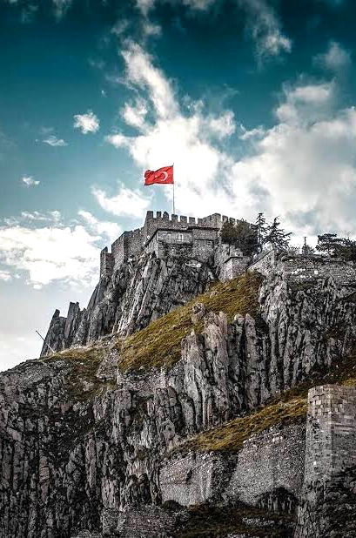
The capital city of Turkey
Introduction
of our city Ankara
PRESENTED BY TEAM TURKEY
Notes:
Now,
we will like to introduce to all of you
our capital (kepitıl) city
Ankara.

Slide 2
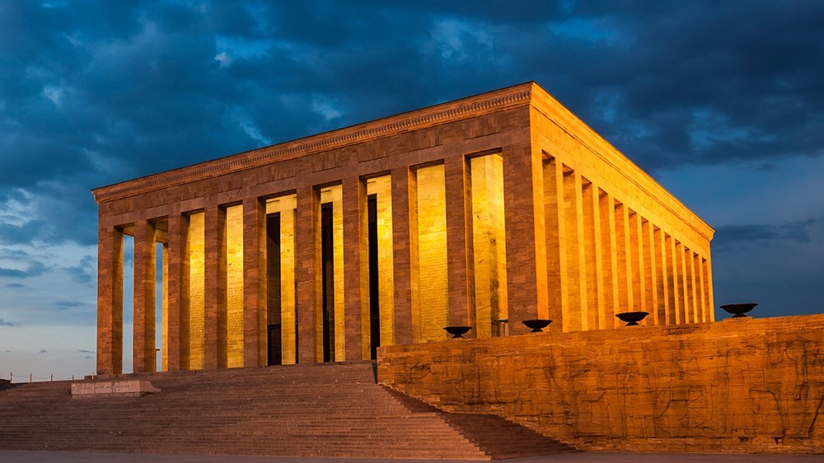
Notes:
Ankara,
historically KNOWN as Angora
is located
in the central part of
Anatolia

Slide 3
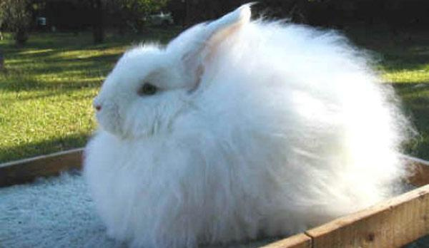
ANGORA RABBİT
Notes:
The city
gave its name
to the (Angora wool shorn)
from Angora rabbit,

Slide 4
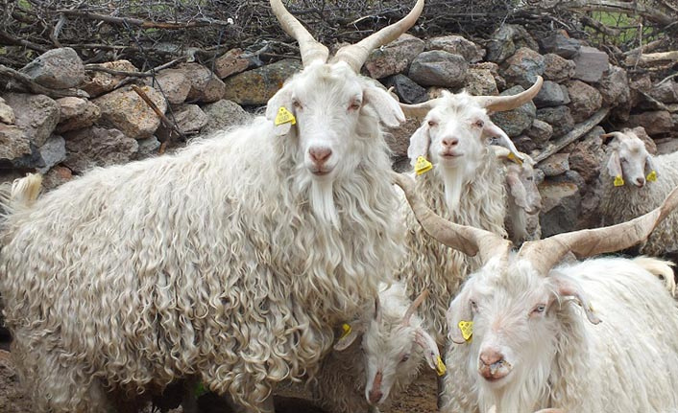
ANGORA GOAT
Notes:
the long-haired Angora goat,

Slide 5
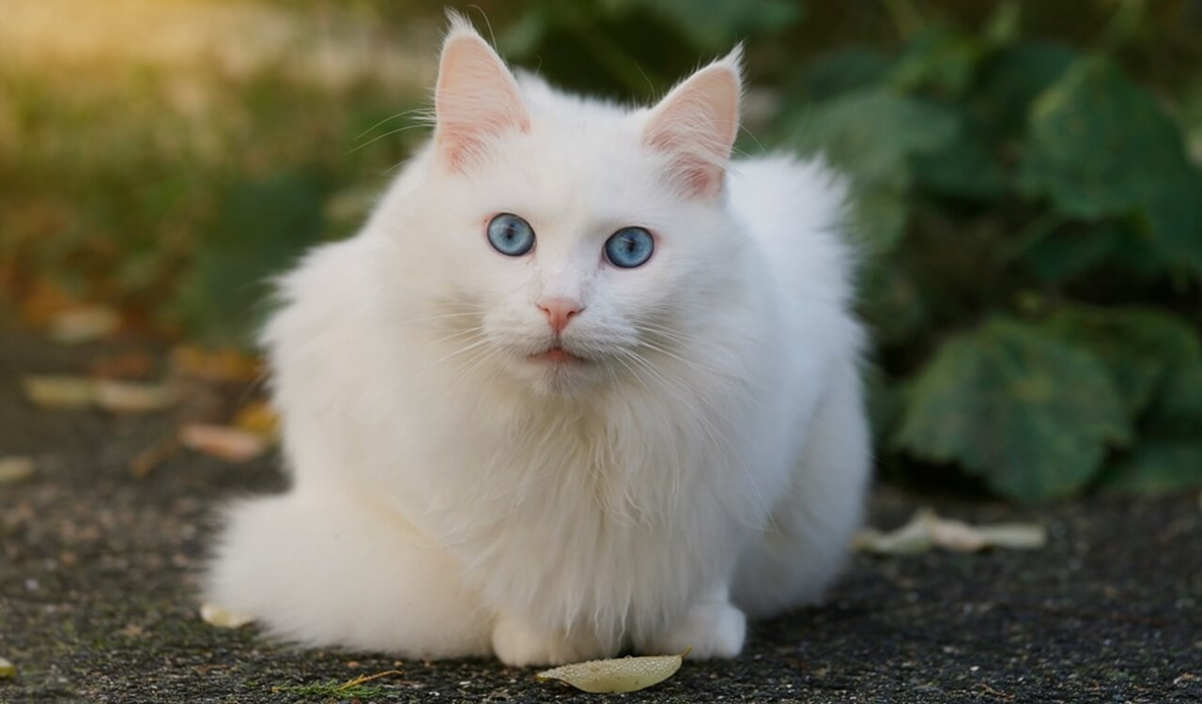
ANGORA CAT
Notes:
AND the Angora cat.

Slide 6
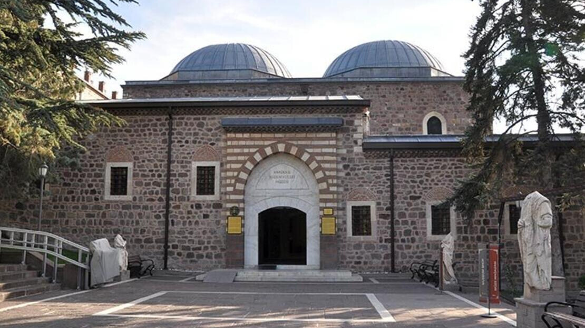
THE MUSEUM OF ANATOLIAN CIVILIZATIONS
Notes:
The history of Ankara
can be traced back
to the Bronze Age Era
of the Hatti
Civilization.
Since Ankara housed,
MANY different civilitions AND
empires,
its cultural heritage
is very UNIQUE
and precious.
Now, let`s watch the video about the Museum of
Anatolian Civizilitions
which is consider to be one of the top museums
with its original collections

Slide 7
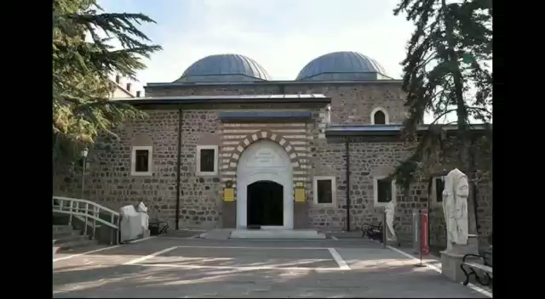
Notes:
Now let's watch the video about Museum of Anatolian Civilizations

Slide 8
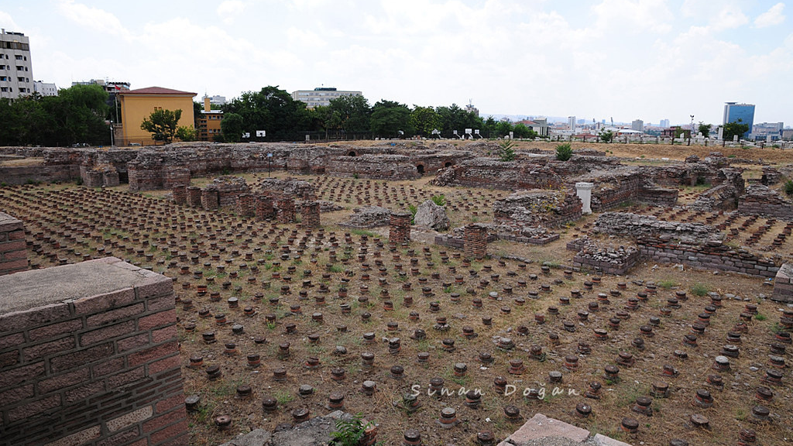
THE ROMAN BATHS
Notes:
Ankara Roman Baths and Open Air Museum
is located on Çankırı Caddesi between Ulus and Yıldırım Beyazıt squares
With the works between 1997-2001 (nineteen nintyseven – two thousand one)
( Ankara Roman Bath Site) has been gained (geyn) an apperance of Open Air Museum)
Here(hiır) is the video.

Slide 9
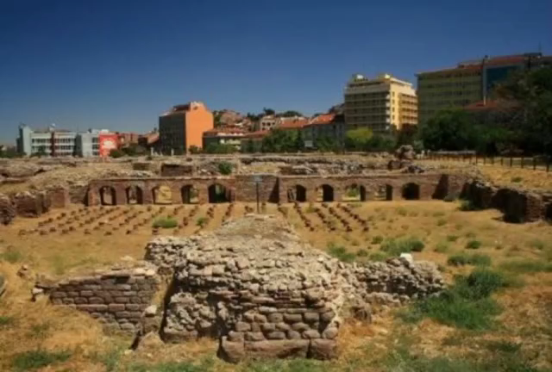
Notes:
Here(hiır) is the video.

Slide 10
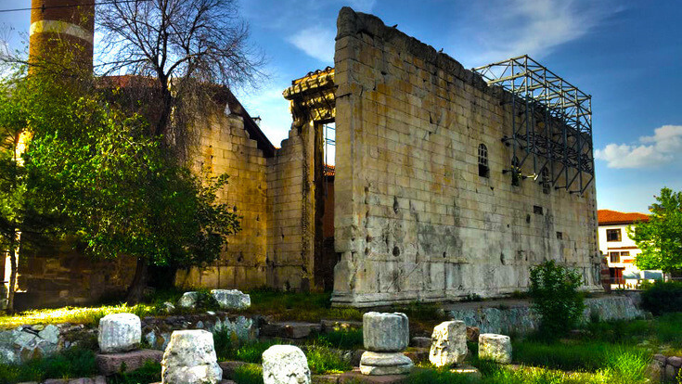
THE TEMPLE OF AUGUSTUS
Notes:
These are the Ruins of the Temple of Roma and Augustus
They are located in Altındağ district in Ankara.
This temple displays the works of Augustus, who is considered (konsidird) the first Roman Emperor.

Slide 11
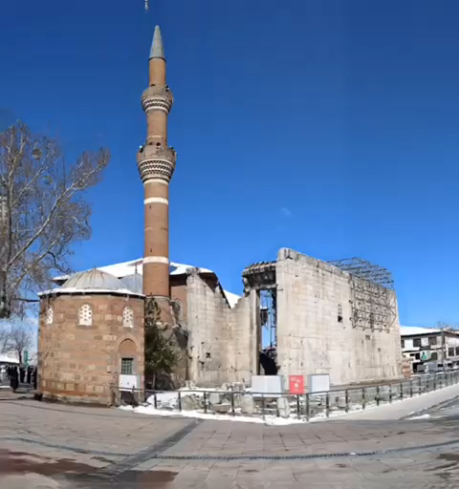
Notes:
Here(hiır) is the video.

Slide 12
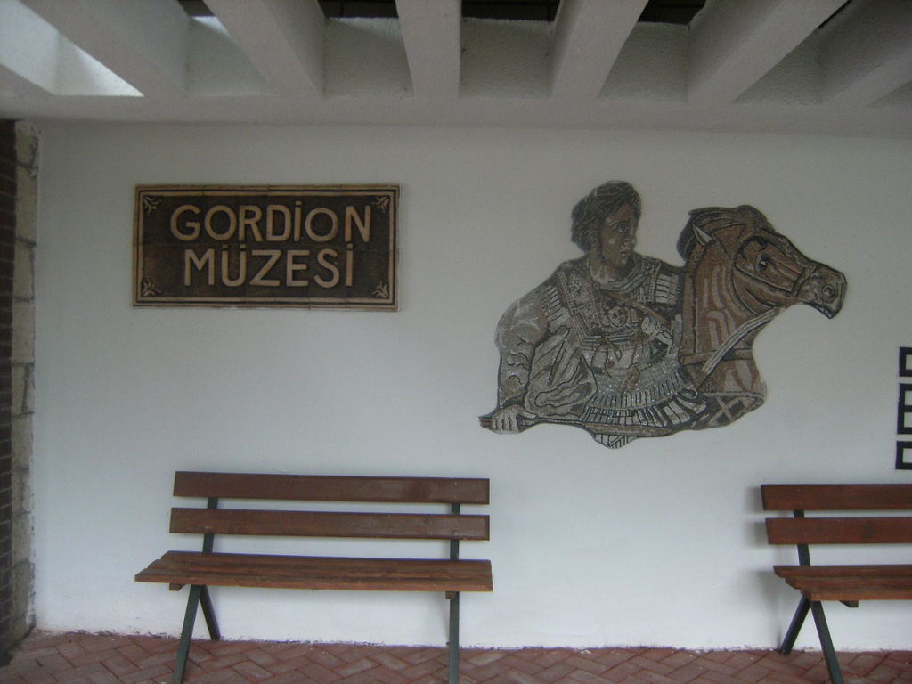
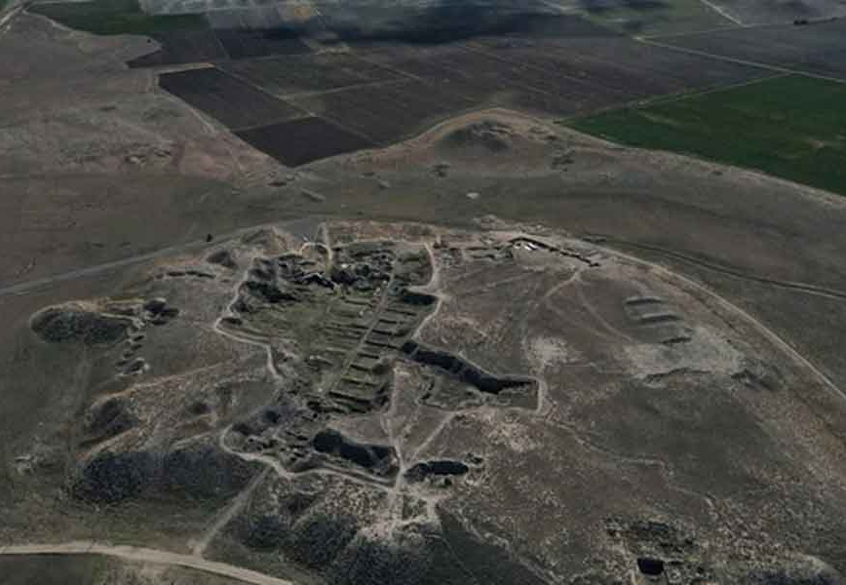
The Historical City
Gordion
Notes:
Gordion Museum is another important museum of Ankara
which is located in Polatlı district.
Gordion is one of the important centers of Asur and Hittites (Hittayts)
Its history goes back to 3000 (three thousand) BC (Before Christ)
Gordion is the capital of Phrygia(Frigya)
Let`s watch(voç) the video

Slide 13
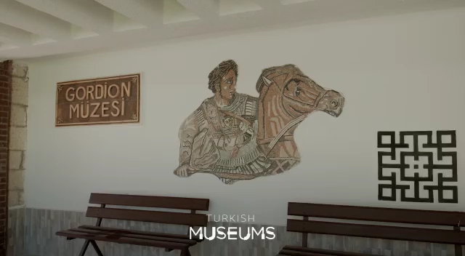
Notes:
Let`s watch(voç) the video

Slide 14
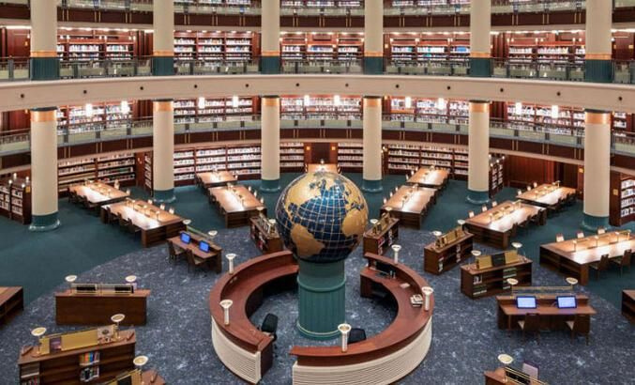
THE NATIONAL LIBRARY
Notes:
Ankara is a real cultural center (s yok) with its libraries,
exhibition centers,
and theaters.
Milli Kütüphane
which is the National Library of Turkey is located in Ankara.
This library has a diverse (daivers) collection of metarials
dating from the early Ottoman Empire
to the present.
It has one of the richest collections in Turkey
It also provides some excellent online resources (risrosısrz)

Slide 15
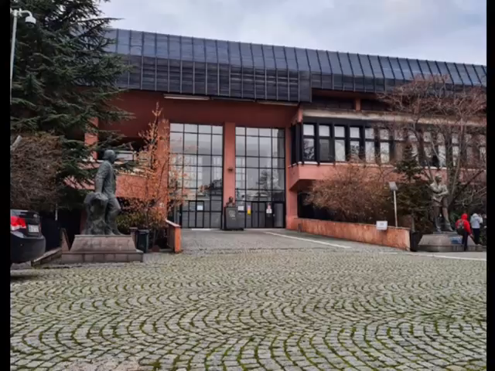
Notes:
Here(hiır) is the video.

Slide 16
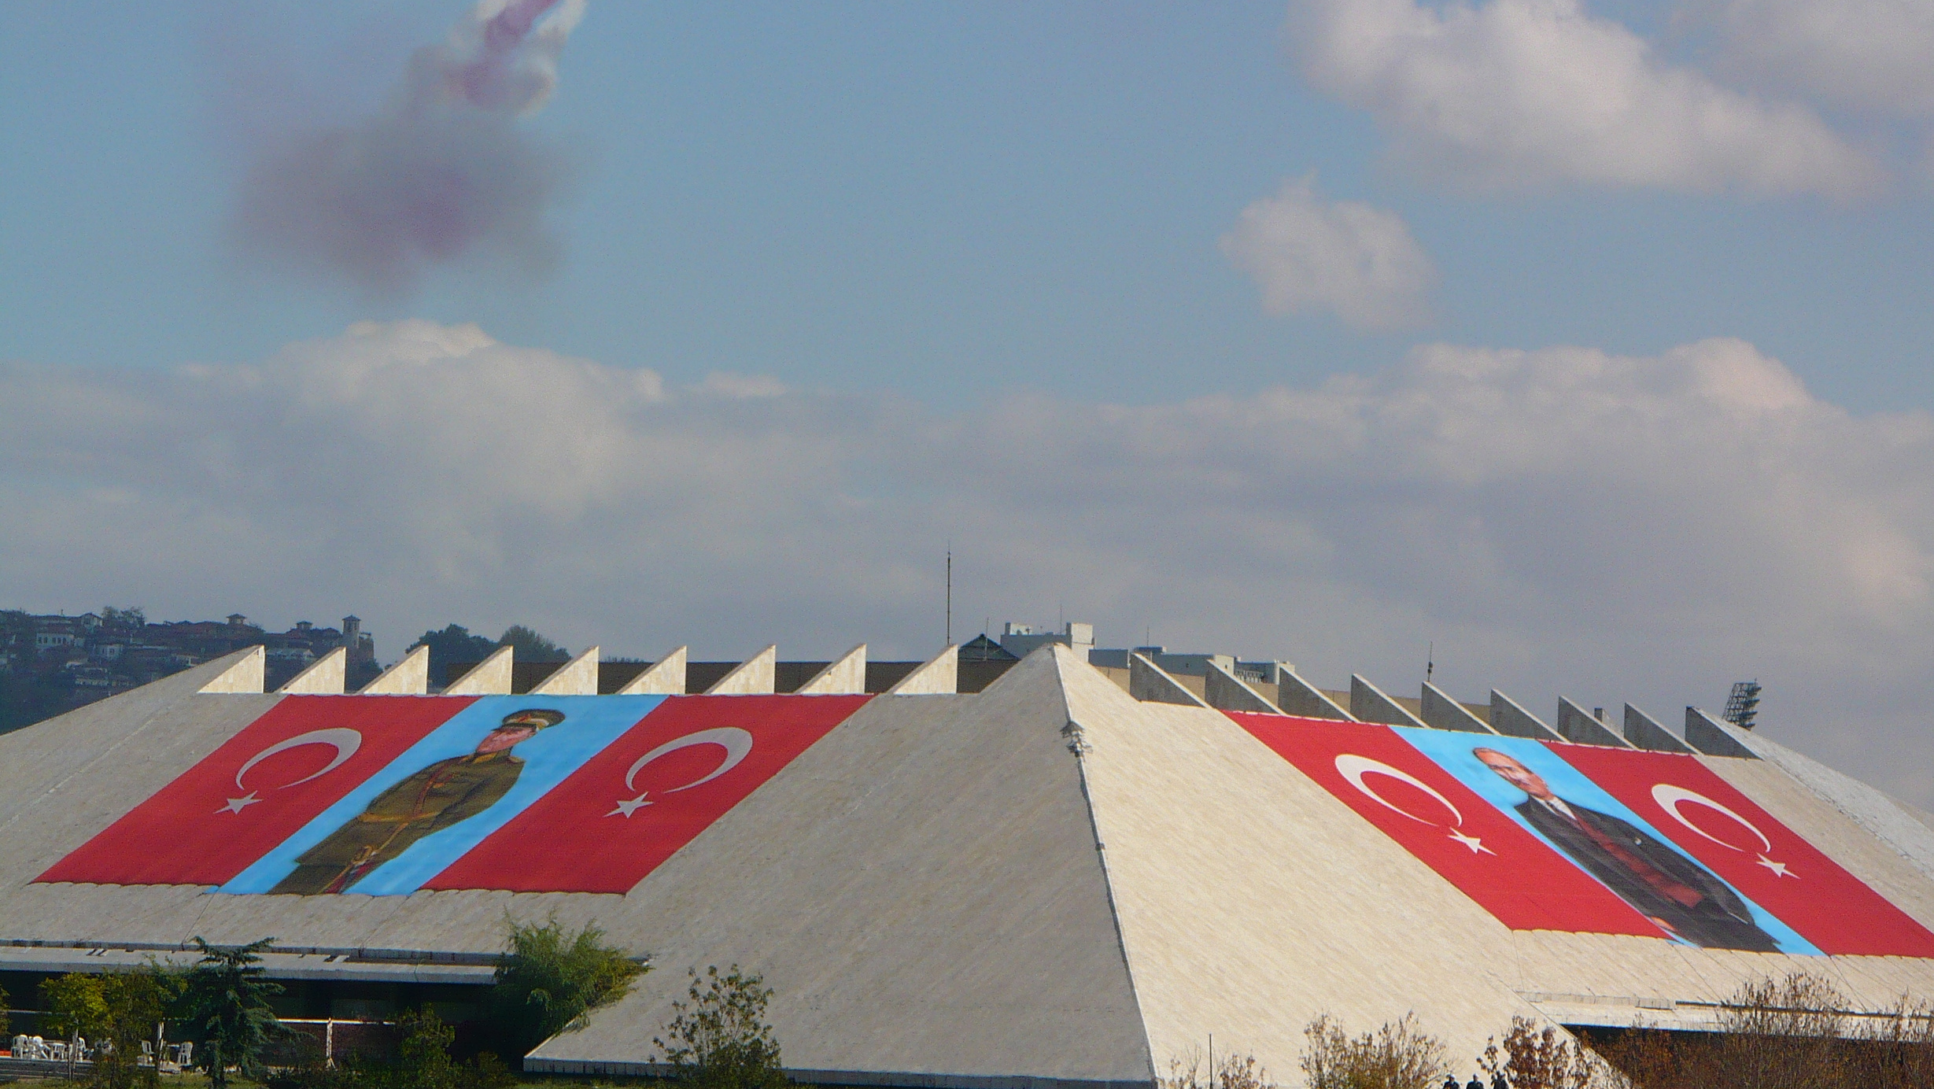
ATATÜRK CULTURAL CENTER
Notes:
Atatürk Cultural Center is located in Altındağ district (distrit) of Ankara.
It is planned (plant)
to be a gift
to the memory of Atatürk
on the 100th (one hundred ) anniversary of his birth.
It has a congress hall ,
concert hall ,
opera-ballet building,
theatre building,
museum ,
and
exhibition hall.

Slide 17
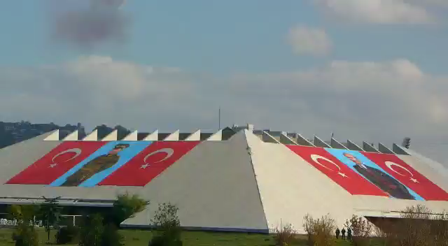

Slide 18
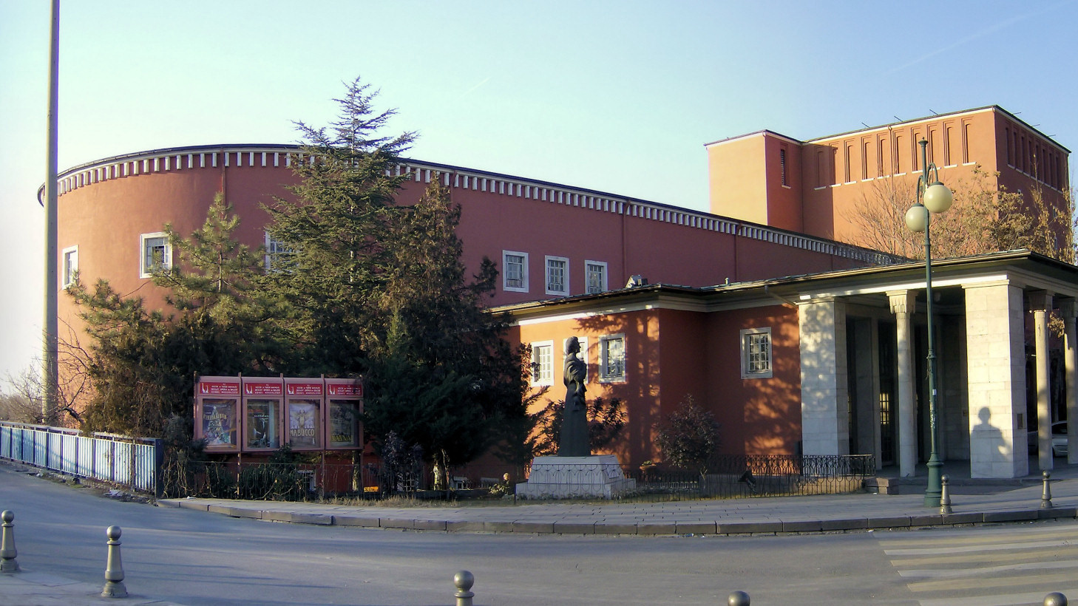
THE OPERA HOUSE
Notes:
Ankara Opera House,
is the largest venue ,
for opera
and ballet.
This building
also serves(sörvs) as a theatre venue
for the Turkish State theatres
under the name of Büyük Tiyatro.

Slide 19
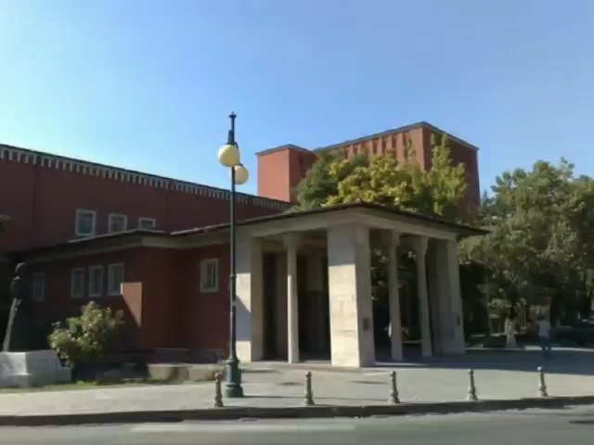

Slide 20
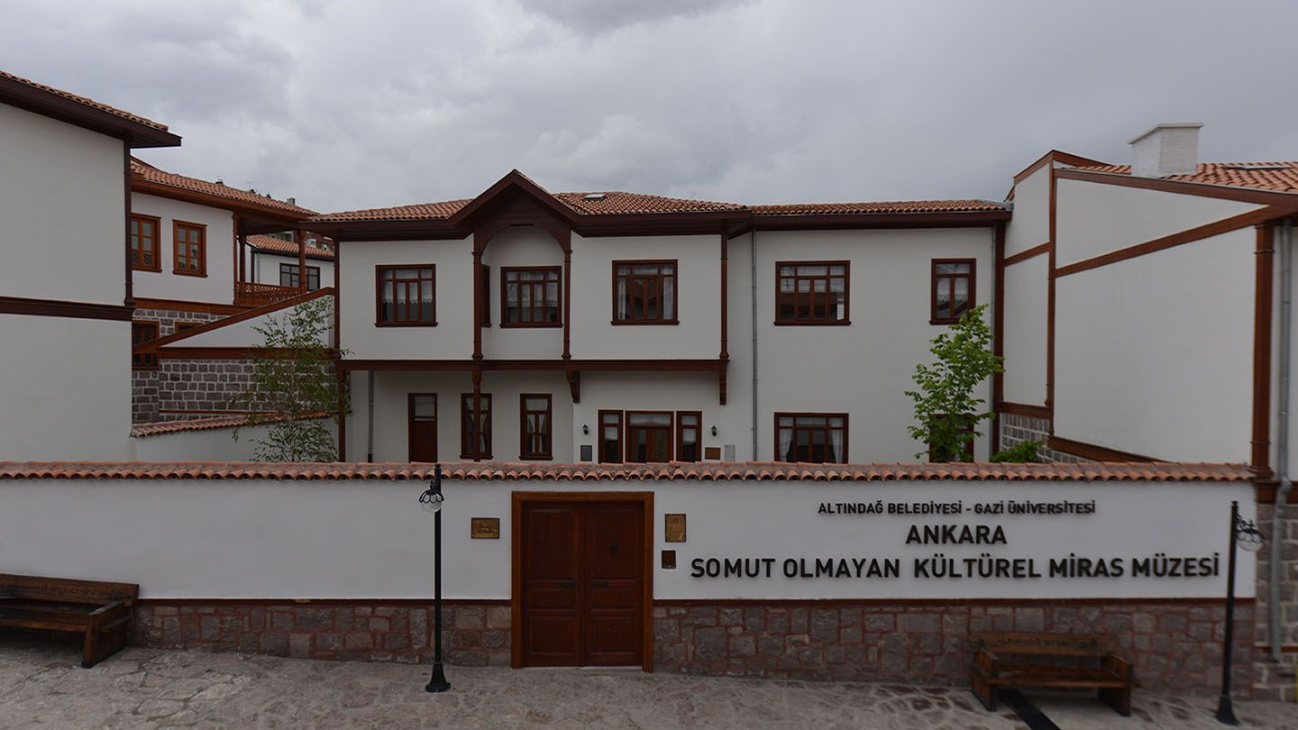
ANKARA INTANGIBLE CULTURAL HERITAGE MUSEUM
Notes:
Now
we will show you a video
Showing
a special museum
displaying
how our cultures used(yust) to live
in Ankara

Slide 21


Slide 22
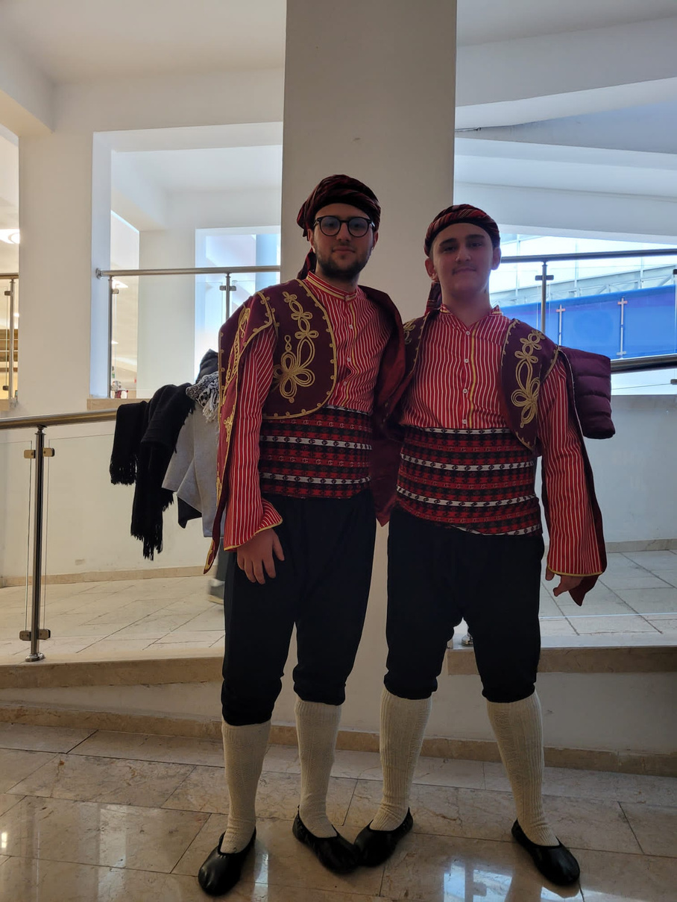
SEĞMENLER
DANCE
Notes:
Because of Ankara`s rich
past culture(kalçır),
the traditions
has been passed along to modern day .
Seğmenler dance
which is a folkloric dance
showing the heroic status of man,
is an example of
past traditions.
Here is the video of seğmen folkloric dance.

Slide 23
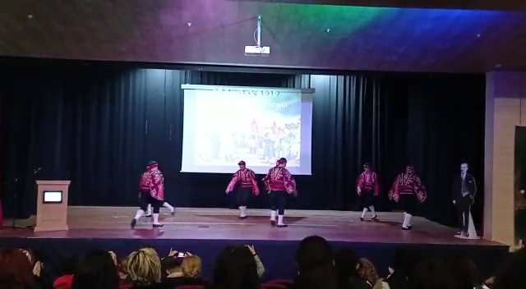
Notes:
Here is the video of seğmen folkloric dance.

Slide 24
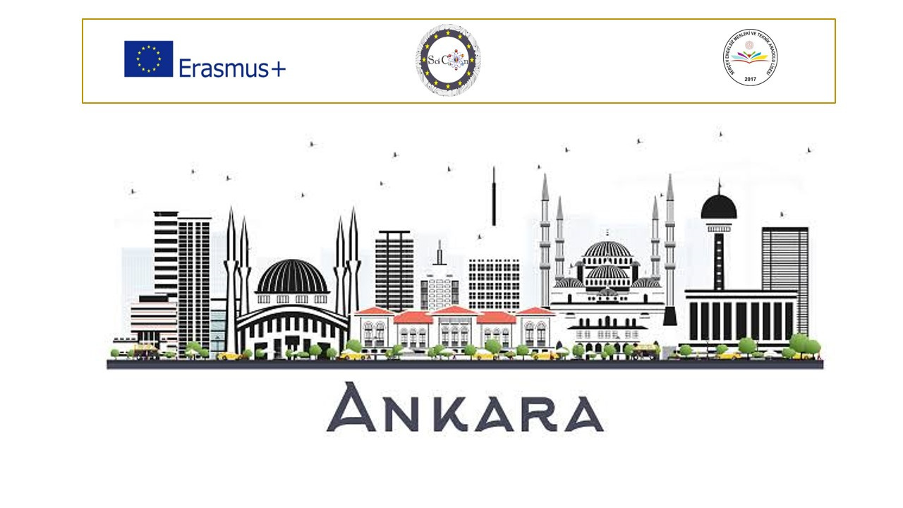
Notes:
We hope that
this
Presention
helps you understand our city Ankara
Thank you for listening

